Slide 1




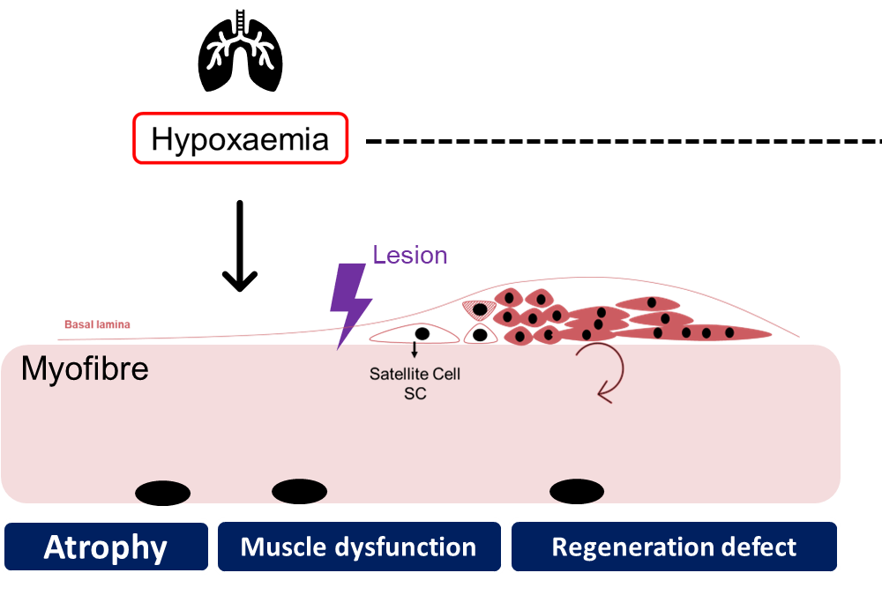
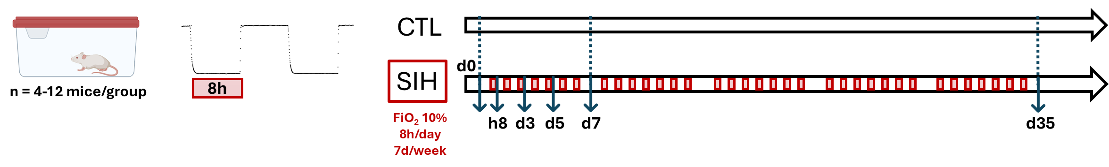
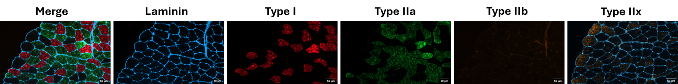
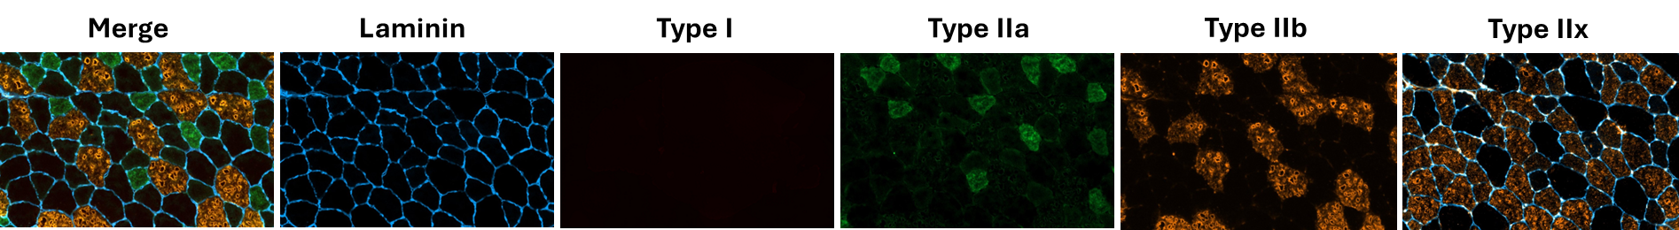
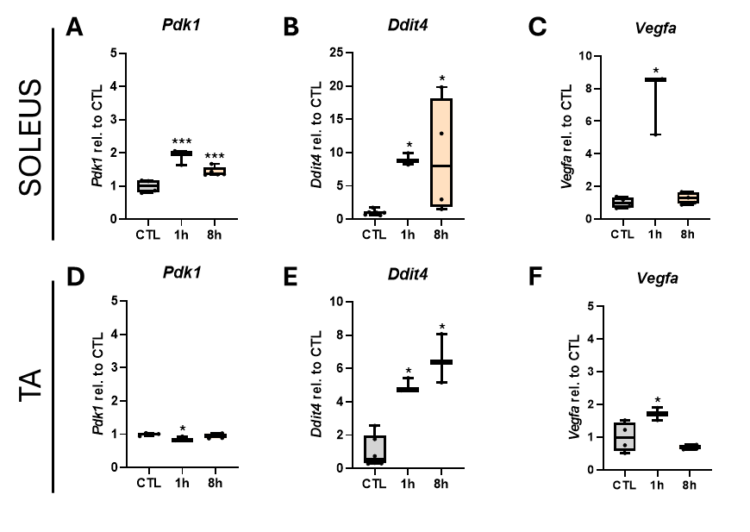
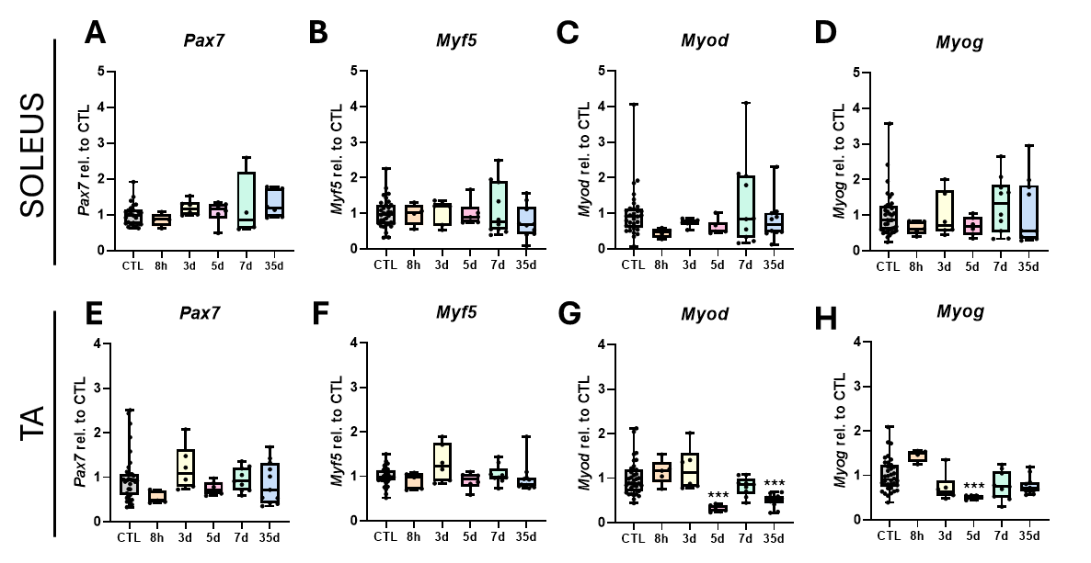
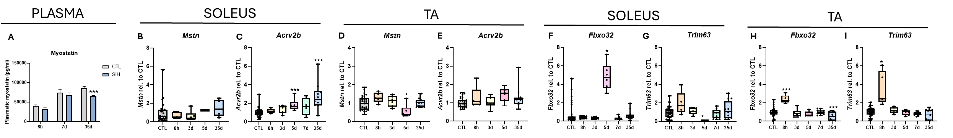


Sustained Intermittent Hypoxaemia as a component of COPD pathophysiology: which effect on skeletal muscle?
Lise Paprzycki¹, Yamina Gourari¹, Alexandre Legrand¹, Carine Michiels², Alexandra Tassin¹
¹Laboratory of Respiratory Physiology, Pathophysiology and Rehabilitaon, Research Instute for Health Sciences and Technology, University of Mons, Mons, Belgium. ²TumHyp-URBC-Narilis, University of Namur, Namur, Belgium.
Introduction
Episodic hypoxaemia, a major pathological component of progressive respiratory insufficiencies, is associated with systemic comorbidities including skeletal muscle dysfunction. The effect of hypoxaemia on skeletal muscle strongly depends on the depth, duration and pattern of hypoxia/reoxygenation phases. Interestingly, an impaired adult myogenesis impacting muscle regeneration is suggested but the underlying mechanisms still need to be clarified.
Aim
Material & methods
To determine specific effects of the hypoxemic component of COPD on muscle structure, mass, functions, and regeneration.
To decipher the specific effect of episodic hypoxaemia on skeletal muscle, we used a reductionist mouse model of Sustained Intermittent Hypoxaemia (SIH; FiO₂: 10%, 8h/day) in a device optimized to avoid movement restriction and to ensure a homogeneous distribution of gaseous flow. Moreover, we limited antioxidant excess by using a specific diet. Muscle structural changes, expression of myogenic markers and regulators of protein synthesis were investigated in fast and slow-twitch muscle fibers at early and late timepoints.
Effect of SIH on myofibre size and myogenic factors in the slow soleus muscle
A
Effet of SIH on myofibre size and myogenic factors in the fast TA muscle
A
A
B
C
D
B
C
D
E
*
F
G
E
F
G
Figure 1. Effect of 35 days of Sustained Intermittent Hypoxaemia (SIH) on mouse soleus muscle (Cross-Sectional Area (CSA) and myofiber size distribution. Soleus muscle cryosection of SIH and CTL mice were submitted to a co-immunofluorescence by using antibodies directed against MyHC7 (type I fibres), MyHC2 (type IIa fibres), MyHC4 (type IIb fibres), MyHC1 (type IIx fibres) and laminin. (B, E) Each myofibre CSA was measured by using the Image J software. Data represented as mean ± SEM. (C, F) Myofibers were classified in clusters according to their area (µm²). (D, G) Cumulative percentage. B. CSA on the whole soleus muscle section; t-test: NS, SIH vs CTL (n=12). E. Soleus type I myofibre CSA; t-test: *: p < 0,05, SIH vs CTL (n=12). C. Whole Soleus fibre size distribution; Chi²: NS (n=12). F. Soleus type I fibre size distribution; Chi²: p < 0;05 (n=12). All analyses were conducted separately for each fiber type; data not shown.
Figure 2. Effect of 7 and 35 days of Sustained Intermittent Hypoxaemia (SIH) on mouse tibialis anterior (TA) muscle Cross-Sectional Area (CSA) and myofiber size distribution. TA muscle cryosection of SIH and CTL mice were submitted to a co-immunofluorescence by using antibodies directed against MyHC7 (type I fibres), MyHC2 (type IIa fibres), MyHC4 (type IIb fibres), MyHC1 (type IIx fibres) and laminin. (B, E) Each myofibre CSA was measured by using the Image J software. Data represented as mean ± SEM. (C, F) Myofibers were classified in clusters according to their area (µm²). (D, G) Cumulative percentage. A. CSA of the whole TA muscle section; t-test: NS (n = 12). E. TA type IIb myofiber CSA; t-test: NS (n=12). C. Whole TA fibre size distribution; Chi²: NS, SIH vs CTL (n=12). F. TA type IIb fibre size distribution; Chi²: NS, SIH vs CTL (n=12). All analyses were conducted separately for each fiber type; data not shown.
HIF1 target gene expression in the SIH model
Myogenic marker expression in the SIH model
Figure 3: Effect of SIH exposure overtime on the expression of HIF1 target genes and modulators of cellular response to hypoxia in soleus and TA muscles. (A-C) RT-qPCR were performed on the soleus muscle by using the ΔΔCt method (housekeeping gene: Rplp0; data normalised to CTL). (A) Pdk1 (encoding PDK1) expression; One Way ANOVA: ***: p < 0.001, 1h and 8h vs CTL (n=4 for CTL, n=3 for 1h, n=5 for 8h). (B) Ddit4 (encoding REDD1) expression; One Way ANOVA: *: p < 0.05, 8h vs CTL (n=4-12 for CTL, n=5-12 for SIH). (C) Vegfa (encoding VEGF) expression; One Way ANOVA: *: p < 0.05, 1h vs CTL (n=4 for CTL, n=3 for 1h, n=5 for 8h). (D-F) RT-qPCR were performed on the tibialis anterior (TA) muscle by using the ΔΔCt method (housekeeping gene: Rplp0; data normalised to CTL). (D) Pdk1 (encoding PDK1) expression; One Way ANOVA: *: p < 0.05, 1h vs CTL (n=4 for CTL, n=3 for 1h, n=4 for 8h). (E) Ddit4 (encoding REDD1) expression; One Way ANOVA: *: p < 0.05, 8h vs CTL (n=4-12 for CTL, n=5-12 for SIH). (F) Vegfa (encoding VEGF) expression; One Way ANOVA: *: p < 0.05, 8h vs 1h (n=4 for CTL, n=3 for 1h, n=4 for 8h).
Figure 4: Effect of SIH on myogenic marker expression in soleus and TA muscles. (A-D) RT-qPCR were performed on the soleus muscle by using the ΔΔCt method (housekeeping gene: Rplp0; data normalised to CTL). (A) Pax7 (encoding PAX7) expression in the soleus muscle; One Way ANOVA: NS (CTL: n=4-12; SIH: n=5-12). (B) Myf5 (encoding MYF5) expression in the soleus muscle; One Way ANOVA: NS (CTL: n=4-12; SIH: n=5-12). (C) Myod1 (encoding MYOD1) expression in the soleus muscle; One Way ANOVA: NS (CTL: n=4-12; SIH: n=5-12). (D) Myog (encoding MYOG) expression in the soleus muscle; One Way ANOVA: NS (CTL: n=4-12; SIH: n=5-12). (E-H) RT-qPCR were performed on the TA muscle by using the ΔΔCt method (housekeeping gene: Rplp0; data normalised to CTL). (E) Pax7 (encoding PAX7) expression in the TA muscle; One Way ANOVA: NS (CTL: n=4-12; SIH: n=5-12). (F) Myf5 (encoding MYF5) expression in the TA muscle; One Way ANOVA: NS (CTL: n=4-12; SIH: n=5-12). (G) Myod1 (encoding MYOD1) expression in the TA muscle; One Way ANOVA: ***: p < 0.001, 5d and 35d vs CTL (CTL: n=4-12; SIH: n=5-12). (H) Myog (encoding MYOG) expression in the TA muscle; One Way ANOVA: ***: p < 0.001, 5d vs CTL (CTL: n=4-12; SIH: n=5-12).
Protein degradation modulator expressions differ in response to SIH
Figure 5: Effect of SIH on protein degradation regulators in plasma, soleus and TA muscles. (A) Plasma Myostatin levels measured by ELISA. Data presented as Mean ± SEM. Two Way ANOVA: ***: p < 0.001, SIH 35d vs CTL 35d (CTL: n=6; SIH: n=6). (B-I) RT-qPCR were performed on the soleus and TA muscles using the ΔΔCt method (housekeeping gene: Rplp0; data normalised to CTL). (B) Mstn (encoding Myostatin) expression in the soleus muscle; One Way ANOVA: NS (CTL: n=4-12; SIH: n=5-12). (C) Acvr2b (encoding ActRIIB) expression in the soleus muscle; One Way ANOVA: ***: p < 0.001, 5d and 35d vs CTL (CTL: n=4-12; SIH: n=5-12). (D) Mstn (encoding Myostatin) expression in the TA muscle; One Way ANOVA: *: p < 0.05, 5d vs CTL (CTL: n=4-12; SIH: n=5-12). (E) Acvr2b (encoding ActRIIB) expression in the TA muscle; One Way ANOVA: NS (CTL: n=4-12; SIH: n=5-12 (F) Fbxo32 (encoding Atrogin-1) expression in the soleus muscle; One Way ANOVA: *: p < 0.05, 5d vs CTL (CTL: n=4-12; SIH: n=5-12). (G) Trim63 (encoding MuRF1) expression in the soleus muscle; One Way ANOVA: *: p < 0.05, 5d vs CTL (CTL: n=4-12; SIH: n=5-12). (H) Fbxo32 (encoding Atrogin-1) expression in the TA muscle; One Way ANOVA: ***: p < 0.001, 8h and 35d vs CTL (CTL: n=4-12; SIH: n=5-12). (I) Trim63 (encoding MuRF1) expression in the TA muscle; One Way ANOVA: *: p < 0.05, 8h vs CTL (CTL: n=4-12; SIH: n=5-12).
Conclusion & prospects
Aknowledgements
We optimized a model allowing to study the specific effect of SIH on skeletal muscle while limiting confounding factors. In this model, we showed alterations in the expression of myogenic markers as well as a muscle hypertrophy taking place over time, mainly in slow-type myofibers. The decreased level of myostatin, a negative regulator of muscle mass, might be involved in the hypertrophy observed in the soleus muscle. Further analysis regarding protein synthesis regulators must be investigated
L.P. benefits from a UMONS-UNamur PhD fellowship.
We thank Raoul Warocqué Foundation for founding the project.
The device allowing hypoxia exposure was funded by ISPPC (CHU Charleroi).
We thank all co-authors of the Chodzyński et al., 2013 (PLoS One. 8(4): e59973) for their collaboration in the initial conception of the device.
We thank B. Blairon and V. Jenart for technical help.
Contact:
lise.paprzycki@umons.ac.be, alexandra.tassin@umons.ac.be

